Slide 1


Neural Networks

Slide 2
A Neural Network
A neural is a biological neural networks in the human brain to process the information. It consists of interconnected nodes, called neurons, organized in layers.
Artificial Neural Network (ANN) refers to neural networks that are designed and used by humans to solve specific tasks in artificial intelligence and machine learning.

Slide 3
Evolution of Neural Networks
1940s-1950s: Early Concepts of Neural networks originated for mathematical model of artificial neurons.
1960s-1970s: Perceptron's characterized this era.
1980s: Backpropagation and Connectionism
1990s: Neural networks surged with applications in image recognition.
2000s: Leveraging numerous layers and revolutionized various domains.
2010s-Present: Deep Learning.

Slide 4
Types of ANNs
Feedforward Neural Network (FNN) are for classification and regression.
Convolutional Neural Network (CNN) accepts Designed grid-like data for video recognition tasks.
Recurrent Neural Network (RNN) are for language modeling.
Long Short-Term Memory (LSTM) for machine translation and sentiment analysis.
Generative Adversarial Network (GAN): for image synthesis and data augmentation.

Slide 5


Slide 6


Slide 7
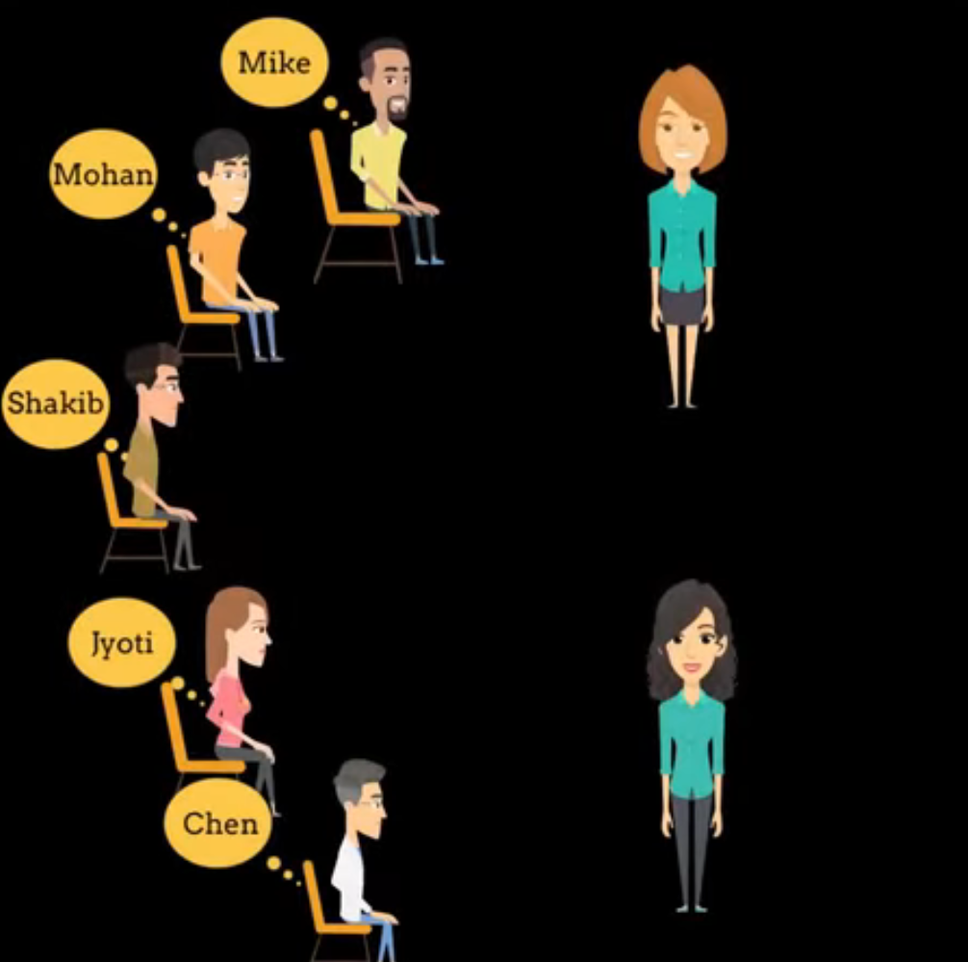



Slide 8
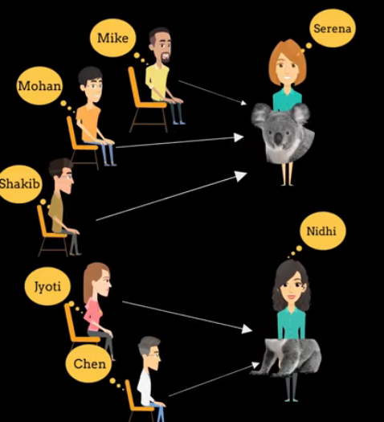

Slide 9
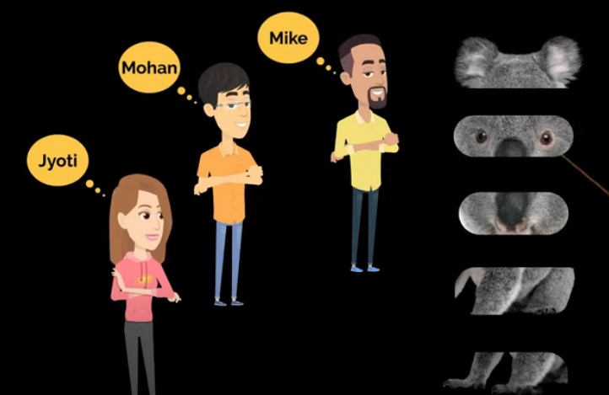


Slide 10
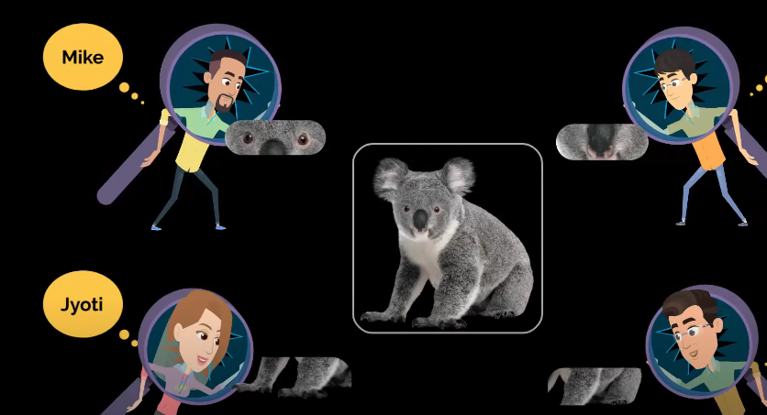



Slide 11
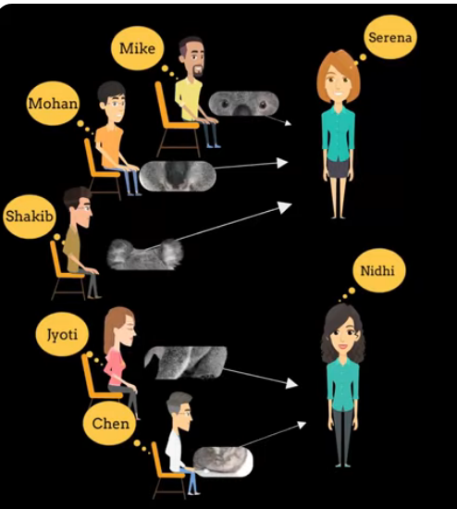

Slide 12
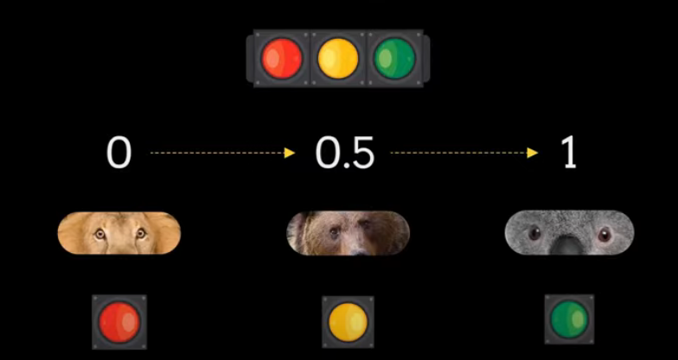

Slide 13
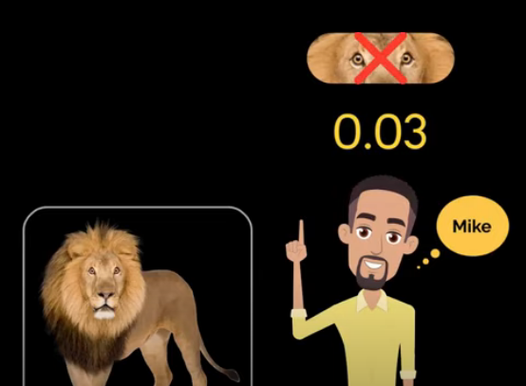
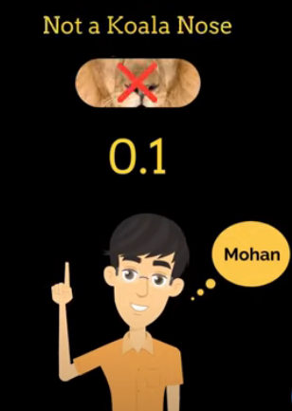

Slide 14



Slide 15
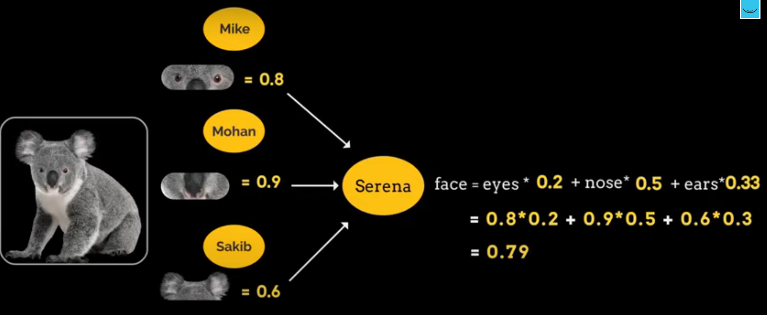

Slide 16
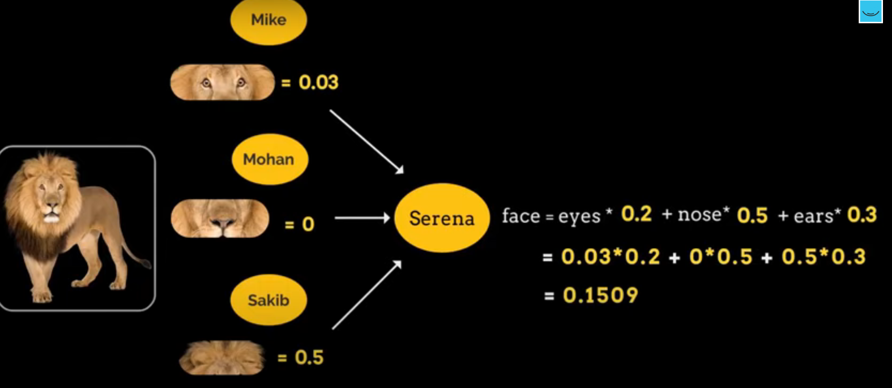

Slide 17
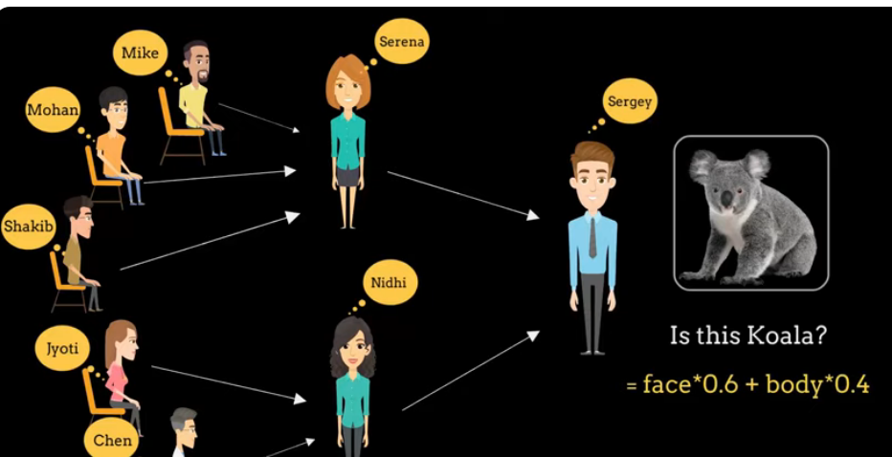

Slide 18
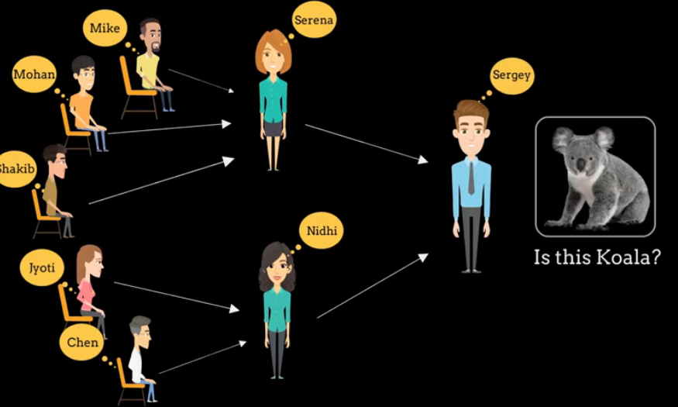
Input nodes
Hidden nodes
Output node

Slide 19
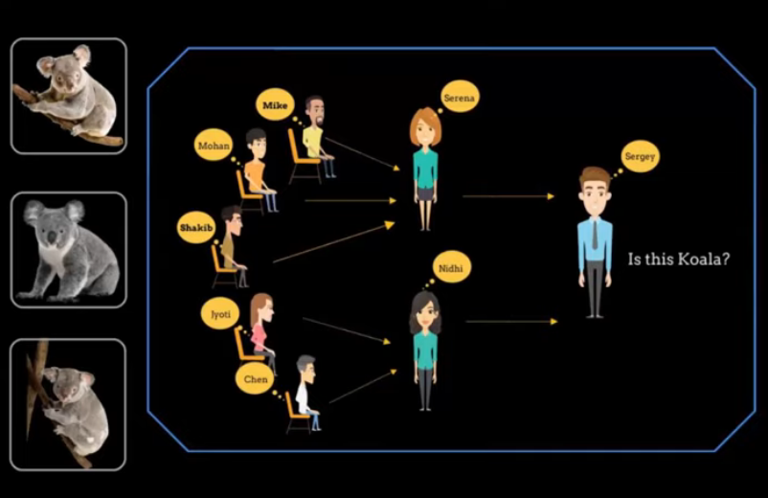

Slide 20
An Artificial Neural Network
Architecture: ANNs typically consist of three types of layers:
Input Layer: Receives input data and passes it to the next layer.
Hidden Layers: Intermediate layers between the input and output layers. Each neuron in these layers applies weights to the input data and passes the result to the next layer.
Output Layer: Produces the final output based on the processed data from the hidden layers.

Slide 21
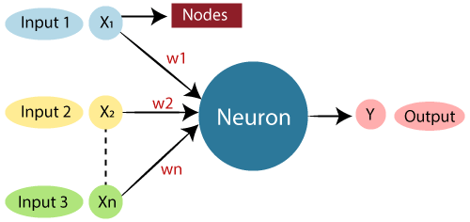
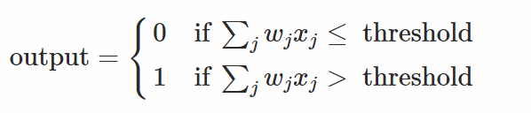
A perceptron
A perceptron processes multiple binary inputs, x1,x2,…, and produces a single binary output.
Each input is associated with a weight w1,w2,w3, which signifies the importance of that input to the output.
The neuron's output, either 0 or 1, hinges on whether the weighted sum of ​∑jwjxj to surpasses a specified threshold value.

Slide 22
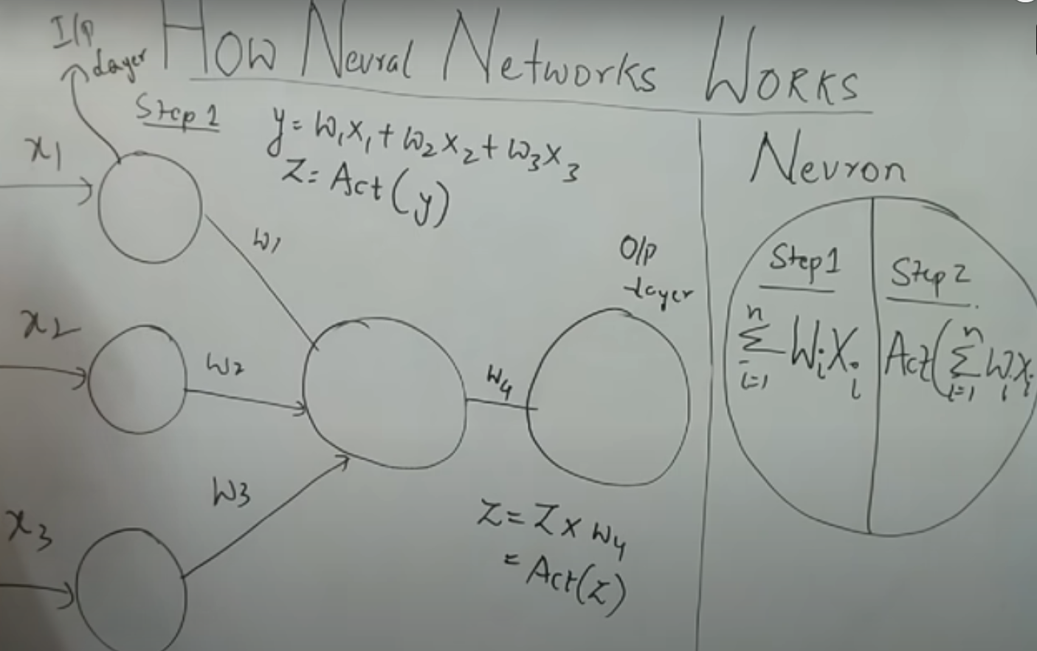

Slide 23
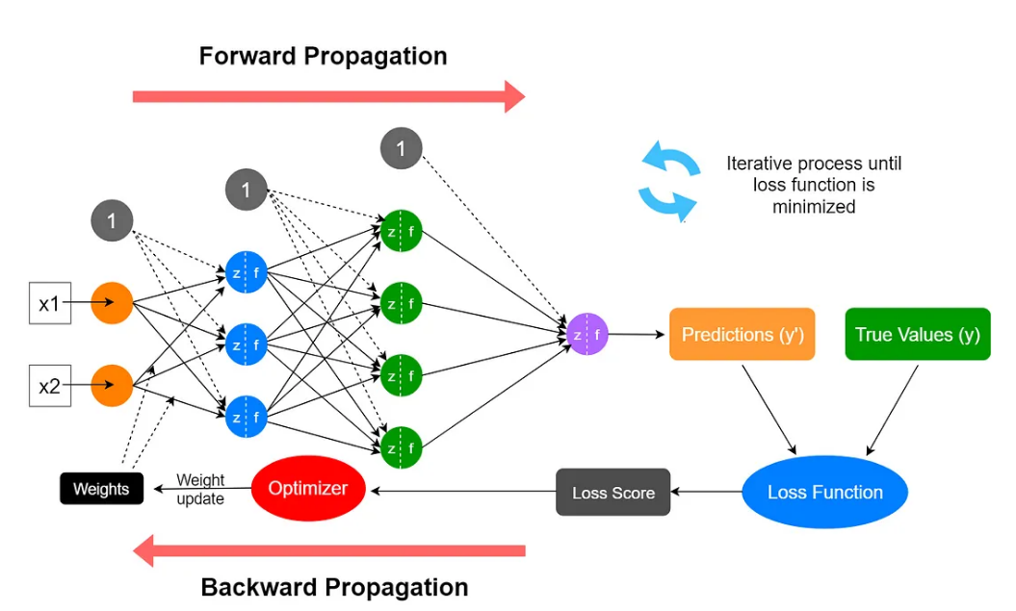

Slide 24
Activation Function
Every activation function (or non-linearity) takes a single number and performs a certain fixed mathematical operation on it. There are several activation functions you may encounter in practice:
Sigmoid: takes a real-valued input and squashes it to range between 0 and 1
σ(x) = 1 / (1 + exp(−x))
tanh: takes a real-valued input and squashes it to the range [-1, 1]
tanh(x) = 2σ(2x) − 1
ReLU: ReLU stands for Rectified Linear Unit. It takes a real-valued input and thresholds it at zero (replaces negative values with zero): f(x) = max(0, x)
Notes

Slide 25
Steps
Importing Necessary Libraries
Loading the Dataset
Splitting Dataset into Input and Output Variables
Defining the tf.Keras Model
Compiling the Model
Fitting the Model
Evaluating the Model

Slide 26
Python Code
# first neural network with keras make predictions
from numpy import loadtxt
from tensorflow.keras.models import Sequential
from tensorflow.keras.layers import Dense
# load the dataset
dataset = loadtxt('pima-indians-diabetes.csv', delimiter=',')
# split into input (X) and output (y) variables
X = dataset[:,0:8]
y = dataset[:,8]
# define the keras model
model = Sequential()
model.add(Dense(12, input_shape=(8,), activation='relu'))
model.add(Dense(8, activation='relu'))
model.add(Dense(1, activation='sigmoid'))
# compile the keras model
model.compile(loss='binary_crossentropy', optimizer='adam', metrics=['accuracy'])
# fit the keras model on the dataset
model.fit(X, y, epochs=150, batch_size=10, verbose=0)
# make class predictions with the model
predictions = (model.predict(X) > 0.5).astype(int)
# summarize the first 5 cases
for i in range(5):
print('%s => %d (expected %d)' % (X[i].tolist(), predictions[i], y[i]))

Slide 27
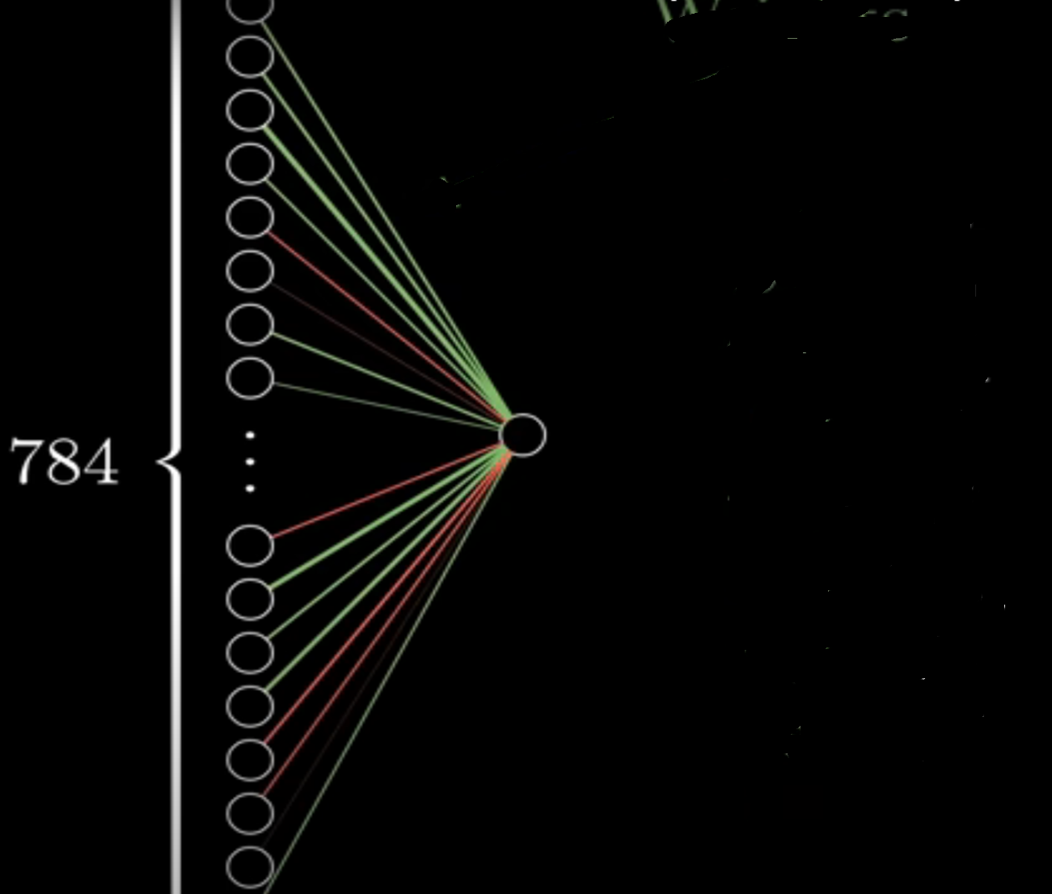

Slide 28
Layer | Type | Number of Nodes | Description
Input Layer | Flatten | 784 | Flattens the 28x28 input images into a 1D array.
Hidden Layer 1 | Dense (ReLU) | 128 | Fully connected layer with 128 nodes and ReLU activation.
Hidden Layer 2 | Dense (ReLU) | 64 | Fully connected layer with 64 nodes and ReLU activation.
Output Layer | Dense (Softmax) | 10 | Fully connected layer for 10 classes with softmax activation.

Slide 29
Example Architectures:
Architecture 1:
Input Layer: 784 nodes (flattened 28x28 image)
Hidden Layer 1: 128 nodes
Hidden Layer 2: 64 nodes
Output Layer: 10 nodes (for 10 classes)
Architecture 2:
Input Layer: 784 nodes
Hidden Layer 1: 256 nodes
Hidden Layer 2: 128 nodes
Hidden Layer 3: 64 nodes
Output Layer: 10 nodes
Architecture 3:
Input Layer: 784 nodes
Hidden Layer 1: 512 nodes
Hidden Layer 2: 256 nodes
Output Layer: 10 nodes
Architecture 4:
Input Layer: 784 nodes
Hidden Layer 1: 256 nodes
Output Layer: 10 nodes
Architecture 5:
Input Layer: 784 nodes
Hidden Layer 1: 128 nodes
Hidden Layer 2: 128 nodes
Output Layer: 10 nodes

Slide 30
Best for Faster Training and Simpler Model: Architecture 1. It is slightly better at generalizing to new data, and its simpler design might make it more suitable when computational resources are limited.
Best for Training Performance: Architecture 3. It has a slightly higher training accuracy and can fit the data better, but might not generalize as well to unseen data, which is important when working with real-world data.

Slide 31
Rule of Thumb for Batch Size:
For small datasets: Try smaller batch sizes (32, 64). This can help improve generalization.
For large datasets: You might be able to use larger batch sizes (128, 256) as these can take advantage of computational efficiency while still allowing for reasonable generalization.
Common Batch Sizes:
32: Common starting point, well-balanced between stability and speed.
64-128: Often used for larger datasets and models, works well when training on GPUs.
256 or larger: Can be used for very large datasets and powerful hardware, but watch out for overfitting.
Example Workflow:
Step 1: Start with a moderate batch size (e.g., 32 or 64).
Step 2: Train the model for a few epochs and monitor the training and validation accuracy.
Step 3: If training is too slow, try a larger batch size.
Step 4: If the model overfits or doesn't generalize well, try a smaller batch size.

Slide 32
Variability is Normal:
neural networks are not deterministic and that slight variations in accuracy are to be expected due to randomness in training.
Real-World Acceptance:
In real-world applications, a slight variation (e.g., ±2%) is acceptable as long as the model performs well on average

Slide 33
Propagate the inputs forward
For unit j in the input layer, its output is equal to its input, that is,
for input unit j.
The net input to each unit in the hidden and output layers is computed as follows.
Given a unit j in a hidden or output layer, the net input is
where wij is the weight of the connection from unit i in the previous layer to unit j; Oi is the output of unit I from the previous layer;
is the bias of the unit

Slide 34
Propagate the inputs forward
Each unit in the hidden and output layers takes its net input and then applies an activation function. The function symbolizes the activation of the neuron represented by the unit. It is also called a logistic, sigmoid, or squashing function.
Given a net input Ij to unit j, then
Oj = f(Ij),
the output of unit j, is computed as

Slide 35
Backpropagation Formulas
Output vector
Output nodes
Hidden nodes
w_{ij}
Input nodes
Input vector: x_{i}

Slide 36
Terminating Conditions
Training stops
All
in the previous epoch are below some threshold, or
The percentage of samples misclassified in the previous epoch is below some threshold, or
a pre specified number of epochs has expired.
In practice, several hundreds of thousands of epochs may be required before the weights will converge.

Slide 37
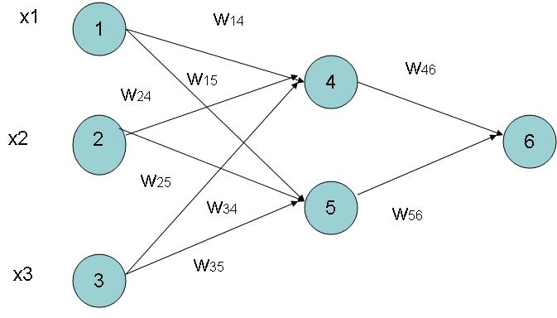
Example of Back propagation
Input = 3, Hidden Neuron = 2 Output =1
Initialize weights :
Random Numbers from -1.0 to 1.0
Initial Input and weight
x1 | x2 | x3 | w14 | w15 | w24 | w25 | w34 | w35 | w46 | w56
1 | 0 | 1 | 0.2 | -0.3 | 0.4 | 0.1 | -0.5 | 0.2 | -0.3 | -0.2

Slide 38
Example ( cont.. )
Bias added to Hidden
+ Output nodes
Initialize Bias
Random Values from
-1.0 to 1.0
Bias ( Random )
θ4 | θ5 | θ6
-0.4 | 0.2 | 0.1

Slide 39
Net Input and Output Calculation
Unitj | Net Input Ij | Output Oj
4 | 0.2 + 0 + 0.5 -0.4 = -0.7
5 | -0.3 + 0 + 0.2 + 0.2 =0.1
6 | (-0.3)0.332-(0.2)(0.525)+0.1= -0.105
= 0.332
= 0.525
= 0.475

Slide 40
Calculation of Error at Each Node
Unit j | Error j
6 | 0.475(1-0.475)(1-0.475) =0.1311 We assume T 6 = 1
5 | 0.525 x (1- 0.525)x 0.1311x (-0.2) = 0.0065
4 | 0.332 x (1-0.332) x 0.1311 x (-0.3) = -0.0087

Slide 41
Calculation of weights and Bias Updating
Learning Rate l =0.9
Weight | New Values
w46 | -0.3 + 0.9(0.1311)(0.332) = -0.261
w56 | -0.2 + (0.9)(0.1311)(0.525) = -0.138
w14 | 0.2 + 0.9(-0.0087)(1) = 0.192
w15 | -0.3 + (0.9)(-0.0065)(1) = -0.306
……..similarly | ………similarly
θ6 | 0.1 +(0.9)(0.1311)=0.218
……..similarly | ………similarly

Slide 42
Thank You

